Slide 1
cri.georgetown.edu
The Case for State Programs, the Current Landscape,
Best Practices and Lessons Learned
Minnesota Secure Choice Retirement Savings Program
Board Meeting
Angela Antonelli
Research Professor and Executive Director
October 4, 2024

Slide 2
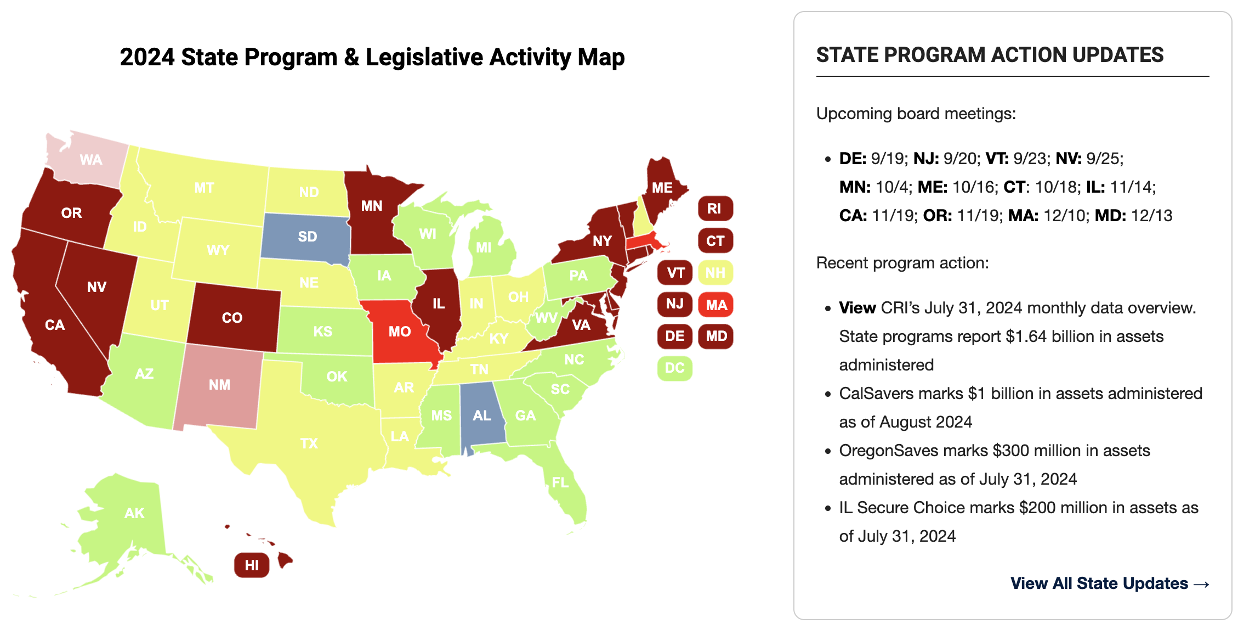
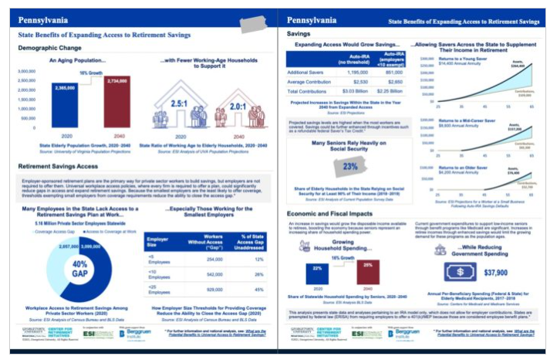
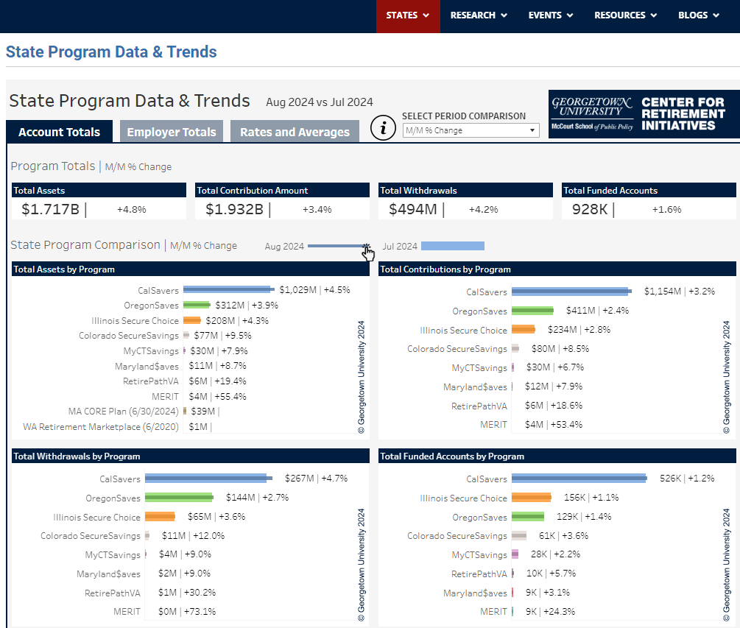
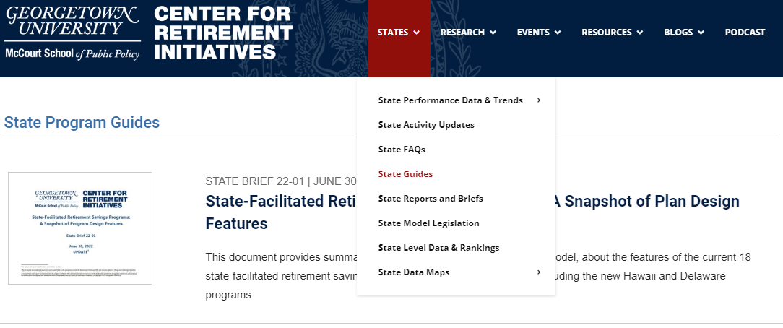
The Georgetown Center for Retirement Initiatives State-Facilitated Retirement Savings Programs Research and Clearinghouse
Working to close the access gap for private sector workers since 2014
Educate and inform about state-facilitated programs
Host the network of the states (monthly and annual meetings)
Provide technical assistance to the states to support legislative and program implementation
Share resources to address legal, policy, and regulatory issues
Maintain a State Resource Center for the states
Maintain and disseminate state program performance data
Share best practices and lessons learned

Slide 3
The Case for State Programs and the Current Landscape

Slide 4
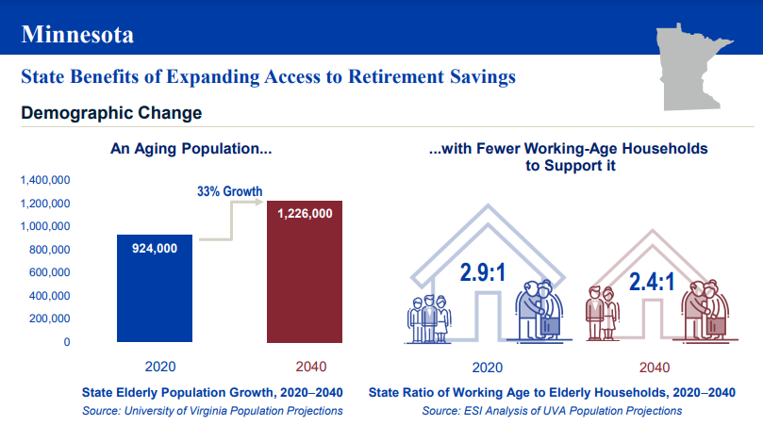
Minnesota’s Demographics Are Changing, Population is Aging
Source: Georgetown University CRI © 2024, Georgetown University

Slide 5
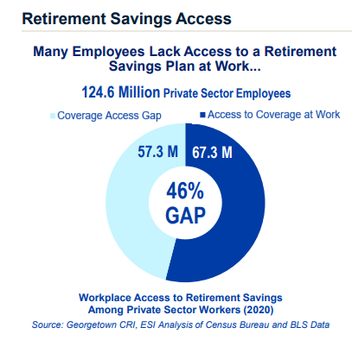
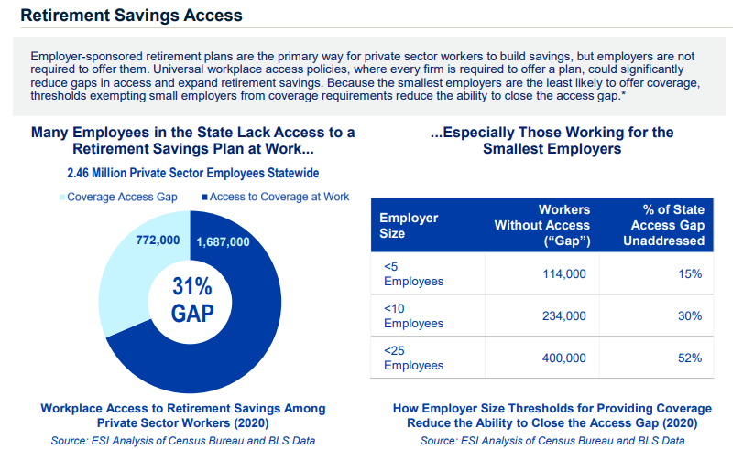
The Access Gap is Large
United States
Minnesota
Source: Georgetown University CRI © 2024, Georgetown University

Slide 6
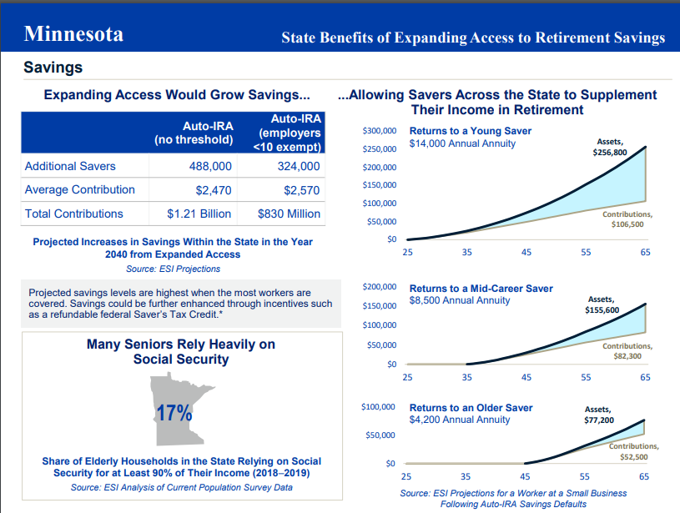
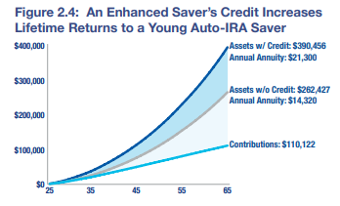
The Benefits Can Be Great
Current Saver’s Match Would Help Boost Savings
Source: Georgetown University CRI © 2024, Georgetown University

Slide 7
While the Cost of Doing Nothing is Significant
Federal Budget Costs = $964 billion/MN share is $23 billion between 2021 and 2024
State Budget Costs = $334 billion/MN share is $5.5 billion between 2021 and 2024
Source: The Pew Charitable Trusts

Slide 8
States Are Driving Change by Designing and Adopting Universal Access Retirement Savings Programs (20 States)
Individual Retirement Account (Auto-IRA)= 17 states | Voluntary Open Multiple Employer Plan (MEP) | Voluntary Payroll Deduction IRA | Voluntary Marketplace
California Maine Oregon | Massachusetts | New Mexico | New Mexico
Colorado Maryland Rhode Island | Missouri |  | Washington
Connecticut Minnesota Vermont
Delaware Nevada Virginia
Hawai’i New Jersey Washington
Illinois New York
Green = program now open to all eligible workers
© 2024, Georgetown University

Slide 9
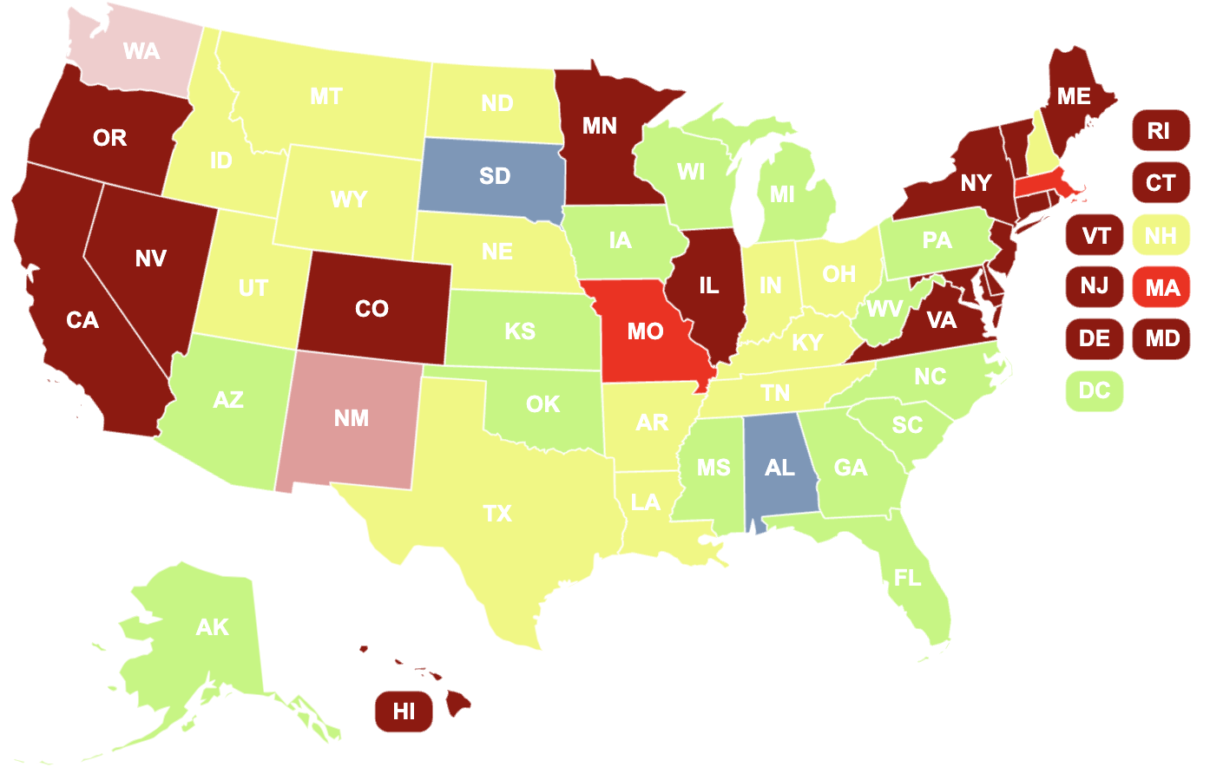
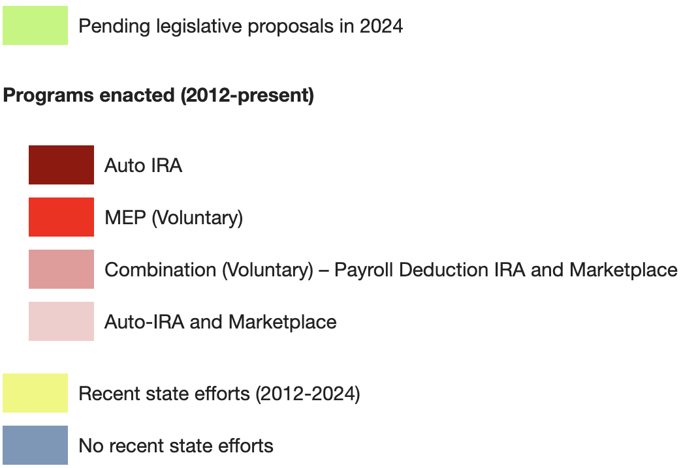
2024 State Programs and Legislative Activity

Slide 10
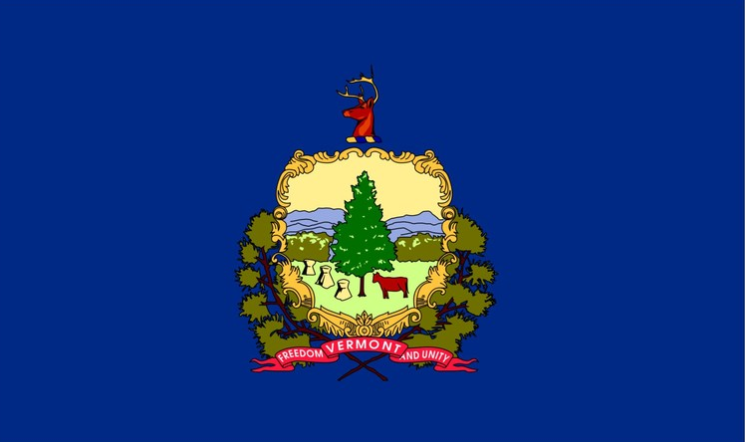
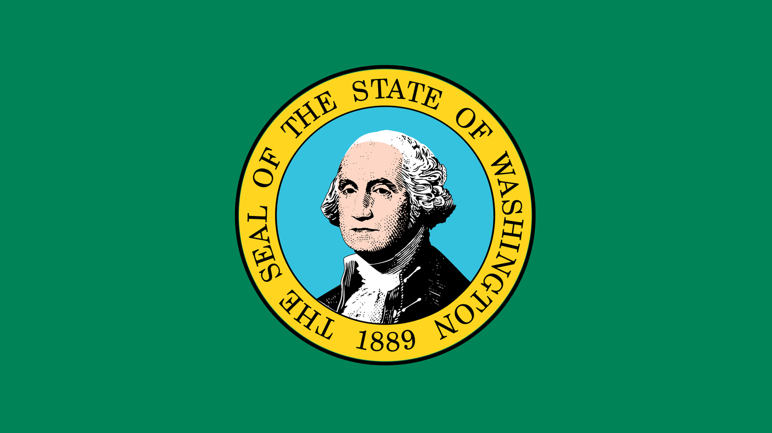
2023 and 2024 New State Programs – Bipartisan Progress
2
0
2
3
2
0
2
3
2
0
2
4
Minnesota
New State Program
Auto-IRA
Nevada
New State Program
Auto-IRA
Rhode Island
New State Program
Auto-IRA
2
0
2
3
2
0
2
3
2
0
2
4
Missouri
New State Program
MEP 401(k)
Vermont
New State Program
Auto-IRA
Washington
New State Program
Auto-IRA
© 2024, Georgetown University

Slide 11
Strong Public, Employer, and Employee Support
NIRS 2024 survey of views of state-facilitated retirement savings programs:
77 percent agree that state-facilitated retirement programs are a good idea with high support across party and generational lines
82 percent say they would participate in state-facilitated retirement programs, consistent across party and generational lines
Many key features of state-facilitated retirement programs viewed favorably
Pew 2019-2020 survey of 2,500 responding employers in Oregon:
79% of the businesses surveyed responded that they paid no out of pocket costs
80% of employers reported that they heard a little or nothing from their employees about participating in the program (assumption is that employees would express any dissatisfaction to their employer)
73% of employers reported being satisfied or neutral about the program overall

Slide 12
State Program Performance
$1.72 Billion in Assets
CA, CO, CT, IL, ME, MD, OR, VA=$1.68 billion
as of 8/31/2024
+MA and WA
221,000+ Registered Employers
CA, CO, CT, IL, ME, MD, OR, VA
as of 8/31/24
927,000+ Funded Accounts
CA, CO, CT, IL, ME, MD, OR & VA
as of 8/31/24
Source: Data compiled by Georgetown CRI from state public and provided data
© 2024, Georgetown University

Slide 13
*Other (Total Assets) includes MyCTSavings, Maryland$aves, RetirePathVA, MERIT, MA CORE Plan, WA Retirement Marketplace.
**Other (Total Registered Employers, Total Funded Accounts) includes MyCTSavings, Maryland$aves, RetirePathVA, MERIT.
All program data is as of August 31, 2024, except for MA Core Plan (as of June 30, 2024) and WA Retirement Marketplace (as of June 30, 2020).
Source: Georgetown CRI state programs database

Slide 14
Total Assets by Program 2020-2024
*Other includes MyCTSavings, Maryland$aves, RetirePathVA, MERIT, Colorado SecureSavings, MA CORE Plan, WA Retirement Marketplace. All program data is as of 8/31/24, except for MA Core Plan (as of 6/30/24) and WA Retirement Marketplace (as of 6/30/20).
Source: Georgetown CRI state programs database

Slide 15
Total Funded Accounts by Program 2020-2024
*Other for Total Funded Accounts includes data from MyCTSavings, Maryland$aves, Colorado SecureSavings, RetirePathVA, and MERIT.
All program data is as of August 31, 2024
Source: Georgetown CRI state programs database

Slide 16
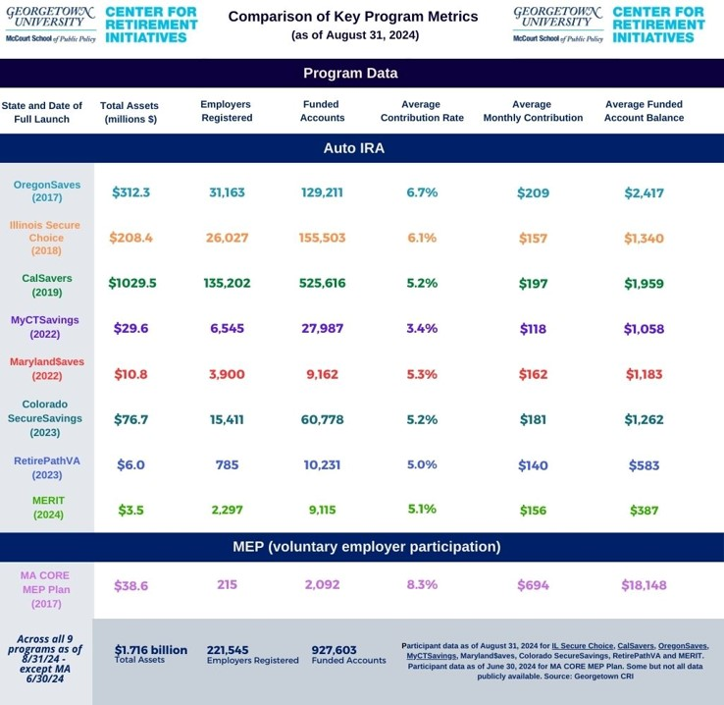
State Programs –Performance Metrics
Average contribution rate stays close to the program default contribution rate
Most savers don’t change their savings rate when auto-escalation occurs
Avg. monthly contribution range: $118-$209

Slide 17
Research Shows State Programs Help Private Plan Growth
Pew Charitable Trust (2023)
Evidence from CA, OR, and IL indicate state programs complement the private sector market for retirement plans
Employers are not enticed by state programs to drop their existing plans
Rate of introduction of new plans as a share of existing plans grew in all three states after program enrollment began (higher than national average): 1.3% in CA; 0.9% in IL; 1.8% in OR
Bloomfield, Lee, Philbrick, Slavov (NBER, 2023) and Bloomfield, Goodman, Rao, Slavov (NBER/CRI, 2024)
Auto-IRA legislation has a positive impact on the likelihood of employers offering retirement plans and employee participation
Firms in states with programs are 1.5-1.7% more likely to offer any employer-sponsored retirement plan relative to firms in states without and workers 3-5% more likely to participate in existing plans
Recent state policies requiring employers to facilitate workplace savings options have induced at least 30,000 firms to establish retirement plans in four of the early adopter states (CA, IL, OR and CT).

Slide 18
Best Practices and Lessons Learned

Slide 19
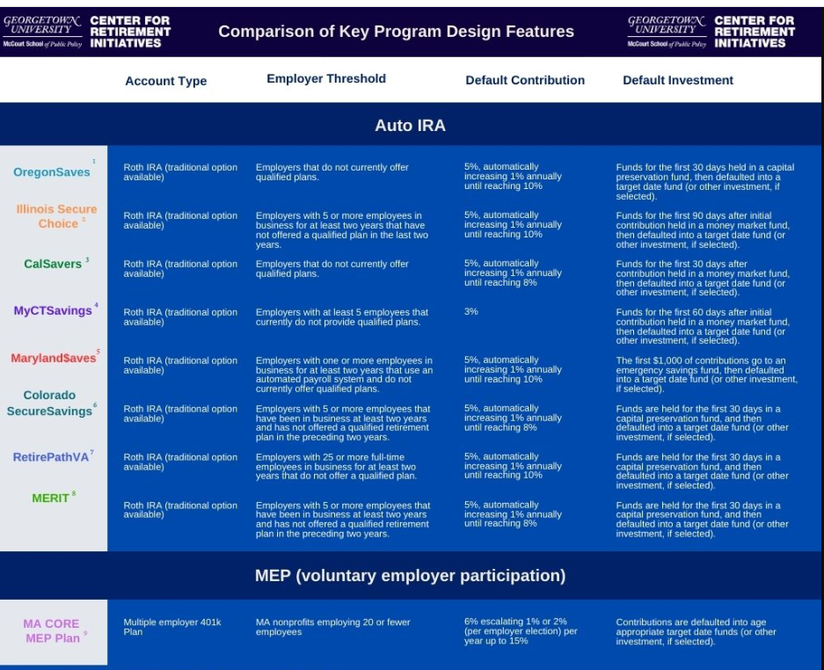
State Auto-IRA Programs –Trend Toward Standardization
Auto-IRA Programs are increasingly becoming standardized in program design:
Roth IRA as default w/ traditional also available
Low employer thresholds
Include independent and gig workers (opt-in)
5% default contribution
Auto-escalation of 1% per year to a cap of 8%-10%
Short asset holding periods
Simple investment menus

Slide 20
Governance and Management Best Practices and Lessons Learned
Best Practices
Develop governance policies
Board education and training is important, notably understanding fiduciary duties
Dedicated program staff and resources are important and delegate
Identify, build, and maintain necessary intra-state relationships with state agencies important for program implementation
View program rulemaking as an opportunity to solicit input from key stakeholders
Determine if you want to use requests for information (RFIs) to better understand provider markets or partnership options prior to any possible request for proposals (RFPs)
Develop compliance policies (issuance of notices; imposition, collection and use of fines)
Anticipate and plan for future budget and legislative needs
Deliver consistency and transparency in public reporting
Lessons Learned
Understand any state administrative requirements, including need for and timing for rulemaking for program design, including compliance
Program data and design details, including access to employer data, compliance policies and funding, all matter to potential service providers
Getting the legislative authority that you don’t have but want/need can take time

Slide 21
Program Design Best Practices and Lessons Learned
Best Practices
Roth IRA as default, with traditional IRA also offered as a choice
Auto-enrollment
Default contribution most commonly starts at 5%
Auto-escalation 1% per year to a cap of 8-10%
Rollout of program first with a pilot and a diverse set of employers and then move to full open for all eligibles
Lessons Learned
Savers stick with defaults and majority don’t act to change
Securing state employer data is important
Program opens to all eligibles, but manage in waves based on employer size (and encourage employers to join at any time and not wait)
No need for long onboarding timelines
Employer movement from registration to payroll contributing accounts can take time

Slide 22
Program Rollout Timelines Have Accelerated

Slide 23
Marketing and Outreach Best Practices and Lesson Learned
Best Practices
Make marketing and outreach a priority and dedicate resources
Hire staff to focus on marketing and outreach
Build bridges to local community organizations
Multi-lingual content dissemination
Community events, webinars, testimonials, social media
Program leaders and staff dedicate time to community outreach and events
Lessons Learned
Failure to invest in marketing and outreach will affect program performance
Don’t forget to focus on employers and value in targeted marketing
Employees often go to their employers about the program, so what employers think matters
Don’t underestimate the level of effort to cover the state, notably reach rural areas

Slide 24
Investments Best Practices and Lesson Learned
Best Practices
Develop an investment policy statement and evaluate investment options
Typically, suite of target date funds, an equity fund, a bond fund, and a capital preservation or money market fund
Default investment is the target date fund
Funds flow into the money market or capital preservation fund for 30-60 days (during the employee opt-out period) and then are deposited in the age-appropriate target date fund
Lessons Learned
Keep the investment options few and simple
Most funds will flow in and remain in target date funds

Slide 25
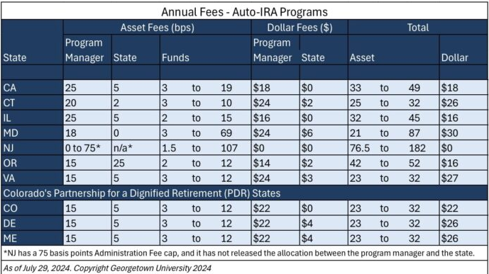
Program Costs and Fees
Early adopters – CA, IL and OR – originally established asset-based fee structures.
Program implementation experience has moved programs to adopt hybrid asset-based and dollar-based fee structures.
This hybrid fee structure is not new to the retirement plan market. The move to dollar-based fees will be better for both the program and participants in the long-term as assets continue to accrue in these programs.

Slide 26
First Inter-State Partnership Launched in 2023
Colorado’s Partnership for a Dignified Retirement
Partner States
Maine - 2023
Delaware - 2023
Vermont - 2024
© 2024, Georgetown University

Slide 27
Partnership Considerations
Two options:
Join the existing Colorado partnership
Create or join a new one
Pros vs. standalone program:
Supports great efficiencies of scale, so program costs/fees for participants and the state should be lower
More attractive to service providers for this reason
State doesn’t have to undertake its own RFP process to hire some vendors
Supports more rapid launch of program (approx. 18 months vs. 8 months) and earlier sustainability
Cons vs. standalone program:
The state will inevitably choose to cede some control of decision-making about program management and features (such as investment selection, etc.), so may take a little more time to make any desired changes
Failure of the state to fully understand any termination provisions or revenue-sharing expectation

Slide 28
Partnership Considerations
What remains the same regardless of standalone or partnership?
States will still need to continue to invest funds in governance and oversight, staff, marketing and outreach, data, reporting, auditing and enforcement.
What has been the first step for new programs considering a state partnership?
For many of the newest program states, one of the first steps taken has been to issue a Request for Information (RFI) to solicit partnership proposals. Three states have issued RFIs that can help MN should it choose to do so: Delaware (2023), Rhode Island (2024), and Nevada (September 2024- currently open). These RFIs have many key questions a state would want to consider related to governance, fees, investments, and program experience.

Slide 29
The Road Ahead– The National Outlook
Continue to add new state programs
Continue to build bridges to increased bipartisan support and adoption of new programs
Expand partnerships among states to streamline administration, keep costs low, and achieve greater efficiencies of scale and generally continue to address other operational issues
Implementation of Secure and Secure 2.0, including the Saver’s Match, and use of new incentives and products intended to make it easier employers to adopt plans
Consideration of federal legislative proposals to expand universal access (with state programs)

Slide 30
Plan to Join Us in Nashville!

Slide 31
Center for Retirement Initiatives McCourt School of Public Policy 125 E Street NW, Suite 530, Washington, DC 20001
202-306-8540 | cri.georgetown.edu
Angela M. Antonelli
Executive Director
ama288@georgetown.edu
Follow us on social media for updates

